Slide 1
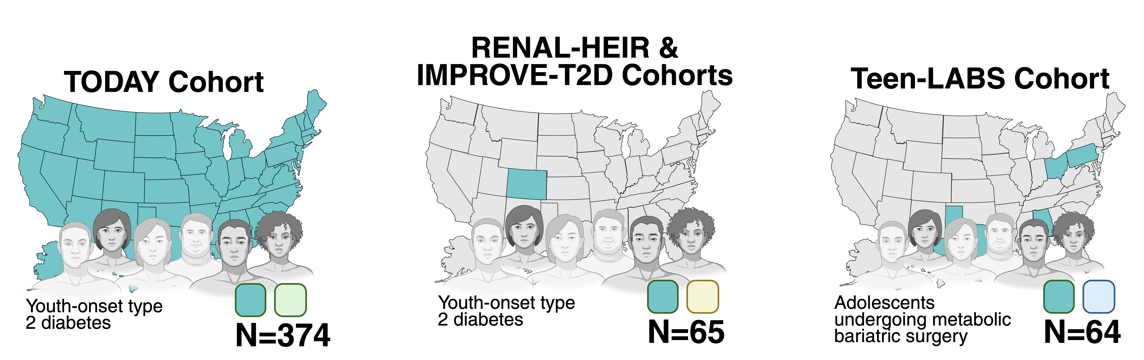
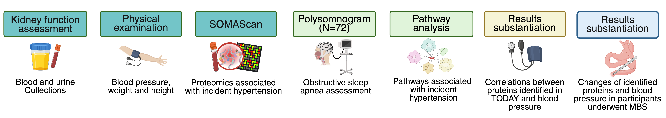
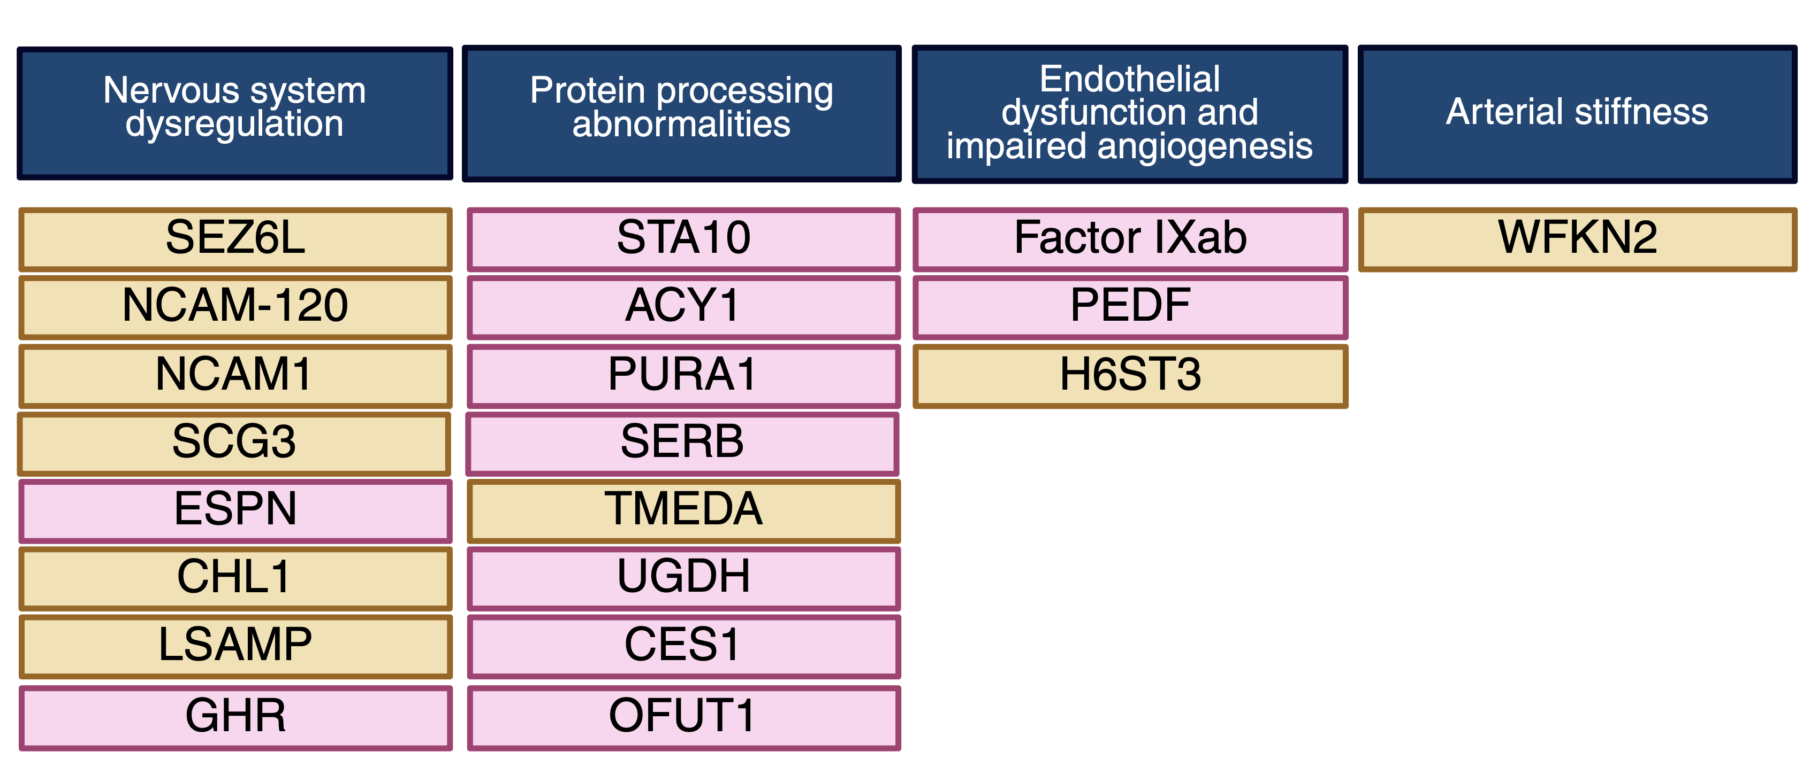
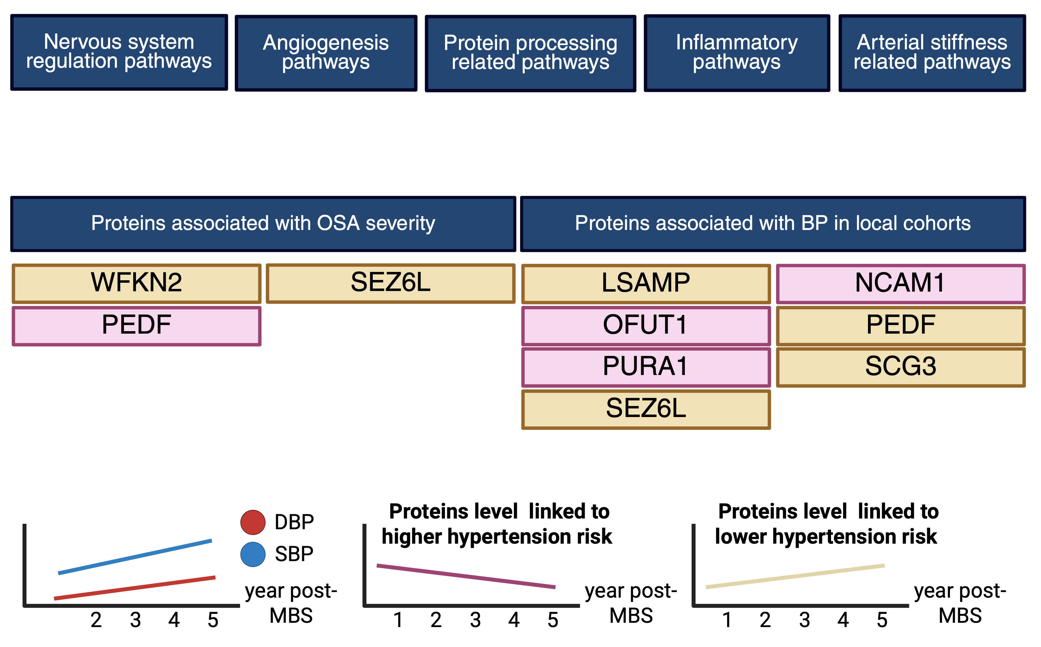

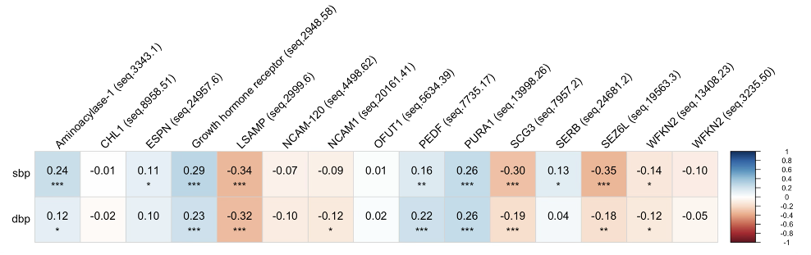
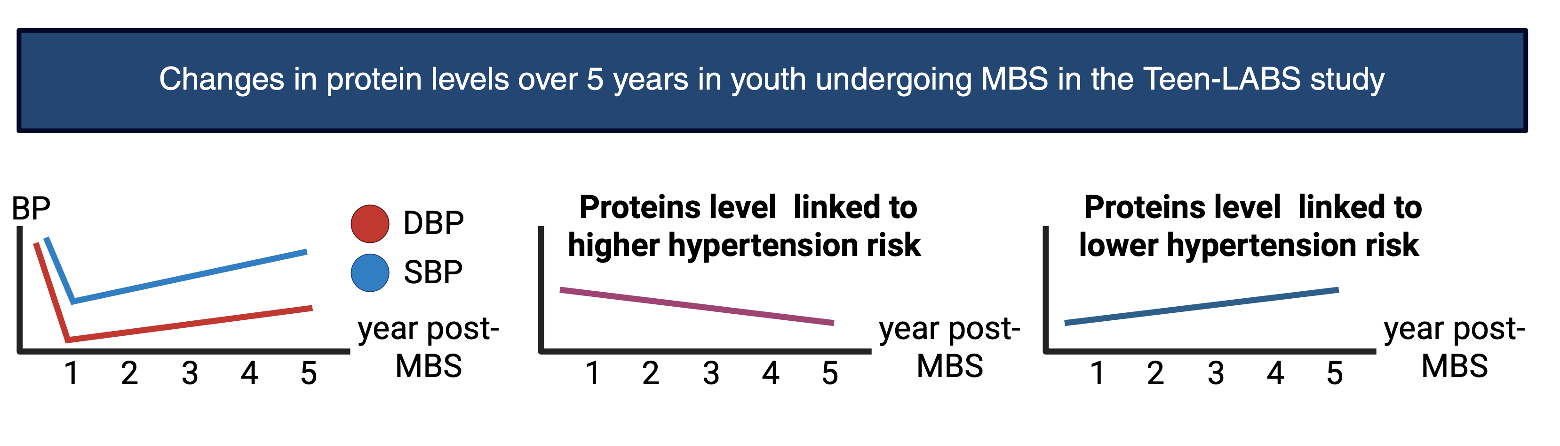




Proteomic Insights into Hypertension in Youth with Type 2 Diabetes:
The Role of Nervous System Dysregulation and Obstructive Sleep Apnea
Phoom Narongkiatikhun^{1,2}, Ye Ji Choi^{1,}, Kalie L Tommerdahl¹, Eliza Blanchette³, Elvira Isganaitis⁴, Kumar Sharma⁵, Sushrut Waikar⁶, Anita Layton⁷, Alexander Kula⁸, Kristen Nadeau⁹, Ian H. de Boer¹⁰, Tim Vigers⁹, Gabriel Cara-Fuentes¹¹, Jane Lynch¹², Karin E. Bornfeldt¹, Tomas Vaisar¹, Vuddhidej Ophascharoensuk², Fida Bacha¹³, Melissa Leroux¹, Hailey Hampson¹, Jairo Pinzon Cortes¹⁴, Jeanie Tryggestad¹⁵, Daniel van Raalte¹⁶, Richard J. Johnson^{17,18}, Lori Laffel¹⁹, Stephen Daniels²⁰, Robert G. Nelson²¹, Justin Ryder⁸, Thomas H. Inge⁸, Todd M. Jenkins²², Laura Pyle¹, Petter Bjornstad¹.
¹Department of Medicine, Division of Endocrinology, Metabolism and Nutrition, University of Washington School of Medicine, Seattle, WA, USA; ²Division of Nephrology, Department of Internal Medicine, Faculty of Medicine, Chiang Mai University, Chiang Mai, Thailand; ³Department of Pediatrics, Section of Nephrology, University of Colorado Anschutz Medical Campus, CO, USA; ⁴Research Division, Joslin Diabetes Center, Boston and Department of Pediatrics, Harvard Medical School, Boston, MA, USA; ⁵Department of Medicine, Section of Nephrology, University of Texas Health San Antonio, San Antonio, TX, USA; ⁶Department of Medicine, Section of Nephrology, Boston University Chobanian and Avedisian School of Medicine, Boston, MA, USA; ⁷Departments of Applied Mathematics, Computer Science, Pharmacy, and Biology, University of Waterloo, Waterloo, ON, Canada; ⁸Department of Pediatrics, Section of Pediatric Nephrology, Lurie Children’s Hospital and Northwestern University Feinberg School of Medicine, Chicago, IL, USA; ⁹Department of Pediatrics, Section of Pediatric Endocrinology, University of Colorado School of Medicine, Aurora, CO, USA; ¹⁰Division of Nephrology, University of Washington School of Medicine, Seattle, WA, USA; ¹¹Department of Pediatrics, Section of Nephrology, Ohio State University, Nationwide Children’s Hospital, OH, USA; ¹²Department of Pediatrics, Section of Pediatric Endocrinology, University of Texas Health San Antonio, San Antonio, TX, USA; ¹³Division of Pediatric Endocrinology and Diabetes, Texas Children's Hospital, Baylor College of Medicine, TX, USA; ¹⁴Division of Endocrinology and Diabetes, Monash University, Melbourne, Australia; ¹⁵Department of Pediatrics, Section of Diabetes and Endocrinology, University of Oklahoma Health, OK, USA; ¹⁶Diabetes Center, Department of Internal Medicine, Amsterdam University Medical Center, Amsterdam, Netherlands; ¹⁷Division of Nephrology, Rocky Mountain VA Medical Center, Aurora, CO, USA; ¹⁸Department of Medicine, University of Colorado Anschutz Medical Campus, Aurora, CO, USA; ¹⁹Joslin Diabetes Center, Harvard Medical School - One Joslin Place, Boston, MA, USA; ²⁰Department of Pediatrics, Section of Cardiology, University of Colorado Anschutz Medical Campus, CO, USA; ²¹Chronic Kidney Disease Section, National Institute of Diabetes and Digestive and Kidney Diseases, Phoenix, AZ, USA; ²²Department of Pediatrics, Cincinnati Children's Hospital Medical Center, Cincinnati, OH, USA
Presenting author contact information: ¹Department of Medicine, Division of Endocrinology, Metabolism and Nutrition, University of Washington School of Medicine, Seattle, WA, USA; Email: pnarong@uw.edu
OBJECTIVE
Incident hypertension is common in youth-onset type 2 diabetes (Y-T2D), often coexisting with obstructive sleep apnea (OSA). This study aimed to explore the interplay between hypertension and OSA in youth with type 2 diabetes.
DESIGN
This prospective cohort study analyzed 6596 proteins (SomaLogic) from baseline plasma samples from the Treatment Options for Type 2 Diabetes in Adolescents and Youth (TODAY) study to identify proteins and pathways related to hypertension development. Cox models evaluated baseline proteins associations with time to hypertension, adjusting for age, sex, ethnicity, and HbA1c. Pathways enriched for incident hypertension were analyzed using Ingenuity Pathway Analysis.
TOP-20 PROTEINS ASSOCIATED WITH INCIDENT HYPERTENSION
BASELINE PATHWAY ANALYSIS RELATED TO INCIDENT HT IN TODAY
SUBSTANTIATION RESULTS IN SUBSET OF TODAY AND LOCAL COHORTS
SUBSTANTIATION RESULTS FROM Teen-LABS COHORT
Heatmap displaying the correlation matrix △protein levels and △SBP and △ DBP from pre-surgery to 1 year after MBS
RESULTS AND CONCLUSIONS
Among 374 participants (mean[±SD] age 14±2 years, 63% female), 61% developed hypertension over 15 years. Several of the top 20 proteins associated with hypertension were related to nervous system regulation, including SEZ6L, NCAM-120, NCAM1, SCG3, ESPN, CHL1, LSAMP, and GHR. SEZ6L also correlated inversely with OSA severity (r:-0.39, p=0.003). Proteins identified in the TODAY study demonstrated similar BP association in an independent cohort. In Teen-LABS, proteins linked to higher hypertension risk decreased, while those associated with lower risk increased, reflecting hypertension attenuation after MBS.
In conclusion, dysregulated nervous system pathways may play a critical role in hypertension in Y-T2D, potentially mediated through OSA
This work was supported by NIH/NIDDK (U01 DK61242) and the American Diabetes Association (7-23-ICTSTDY-08).

Slide 2

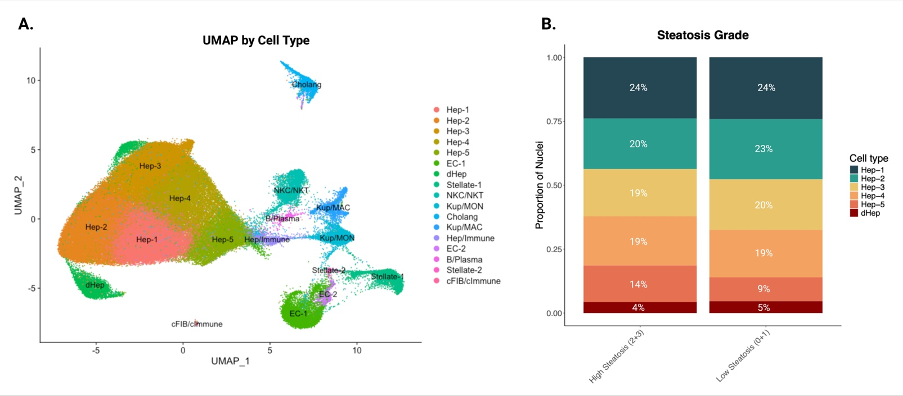
Hepatic Transcriptional Signatures in Youth with High Steatosis Reveal Attenuated Immune Response, Metabolic Dysfunction, and Extracellular Matrix Remodeling
Hailey E. Hampson^{1,3}, Ye Ji Choi², Phoom Narongkiatikhun¹, Jairo ¹, Dylan¹, Kalie Tommerdahl¹, Jesse A. Goodrich³, Laura ^{Pyle1,2}, Melanie Cree^{2*}, Petter Bjornstad^{1,2*}
¹UW Medicine Diabetes Institute, University of Washington School of Medicine, ²Section of Endocrinology, Department of Pediatrics, University of Colorado School of Medicine, ³Department of Medicine, Keck School of Medicine, University of Southern California
BACKGROUND
Metabolic dysfunction-associated steatotic liver disease (MASLD) affects 14% of adolescents globally¹ and is the leading cause of liver-related mortality and obesity is a major risk factor.²
Objective: This study aimed to examined transcriptional alterations in untargeted hepatic genes as well as targeted hepatic genes shown to be strongly associated with hepatic lipid accumulation and liver disease, including MTOR, GCKR, APOC3, PNPLA3 and TM6SF2, among youth with high and low grades of steatosis.
METHODS
Study Design & Data Collection
Data were pooled from three cohorts of youth with obesity who underwent liver biopsies (N = 10):
The Bariatric Surgery Assessment multi-tissue biobank (n = 2 with obesity)
The Hepatic Fat Content and Mitochondrial Flux in Obese Youth Before and After Bariatric Surgery study (n = 5 with obesity)
The Impact of Metabolic Surgery on Pancreatic, Renal and cardiOVascular HEalth in Youth With Type 2 Diabetes (T2D) study (n = 3 with obesity plus T2D).
Participants were categorized by histologic steatosis: high (grade 2 or 3) or low (grade 0 or 1).
Single-nucleus RNA sequencing (snRNAseq) was performed on 130,101 hepatocyte using Seurat v5.³
Statistical Analysis
Differential expression analyses were performed with negative binomial mixed-effects models, including an individual-level random intercept to address intra-individual correlation, using the NEBULA package in R.⁴
Analyses were conducted on pooled hepatocytes and across six subtypes (Hep-1 to Hep-5 and degenerative hepatocytes [dHep]; Figure 1A).
RESULTS
Figure 1. A) Uniform Manifold Approximation and Projection (UMAP) of all hepatic cell types from 10 young adult biopsies, that underwent single nuclei RNA sequencing and clustering; B) Bar chart displaying the proportion of each hepatocyte cell type from youth biopsies with high steatosis and low steatosis.
Figure 2. Significant differential expression of the top 2000 highly variable genes from A. all 103,101 hepatocyte nuclei, and B. 4674 degenerative hepatocyte nuclei between individuals with high versus low steatosis (significant at FDR-P<0.05). Positive log fold-change values refer to greater expression among high steatosis versus low.
CONCLUSIONS
This work was supported by NIH/NIDDK, American Heart Association, Children’s Hospital Colorado Research Institute, Colorado Clinical and Translational Sciences Institute (CCTSI), NIH/NIEHS (T32ES013678)
https://pmc.ncbi.nlm.nih.gov/articles/PMC11925440/
https://pmc.ncbi.nlm.nih.gov/articles/PMC10583766/
https://satijalab.org/seurat/
https://cran.r-project.org/web/packages/nebula/index.html

